Slide 1
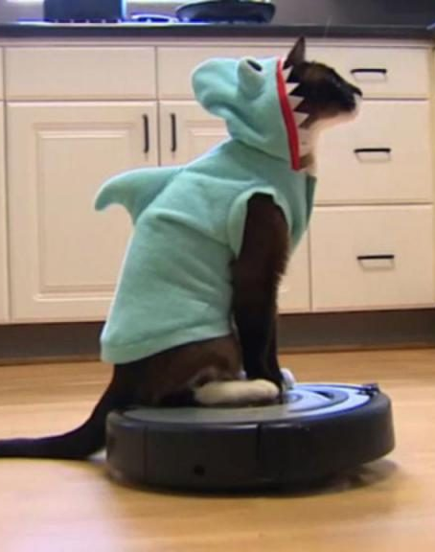
Path Planning!
Meow: This will just be a summary of the key concepts. Please watch lecture slides for more details on the concepts.

Slide 2
Content
Collision Detection in the RVC Toolbox.
Bounding boxes for robotic arms
Configuration-Space (C-space)

Slide 3
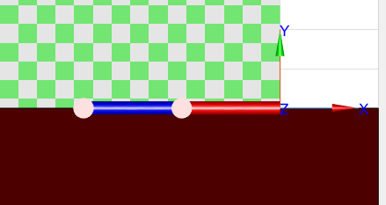
Collision Detection In RVC Toolbox
Not possible, no functionality has been provided for robotic arms.
Get around it by looking at pose of joint 1 and pose of joint 2. (Yellow Circles)
If any of them collide with anything we have a collision.

Slide 4
Disadvantages of this method
Can anyone guess/suggest any?

Slide 5
Disadvantages of this method
Can anyone guess/suggest any?
We only look at 2 points. What about the remaining body of the robotic arm?
Not considering the diameters of the links, only an infinitesimal small point.
Buuuuut…. That’s okay for us. Cause we’re just learning.

Slide 6
Okay so. Real World. What happens?
It’s complicated… Like computationally complicated.
Lets look at bounding boxes in the real world.

Slide 7
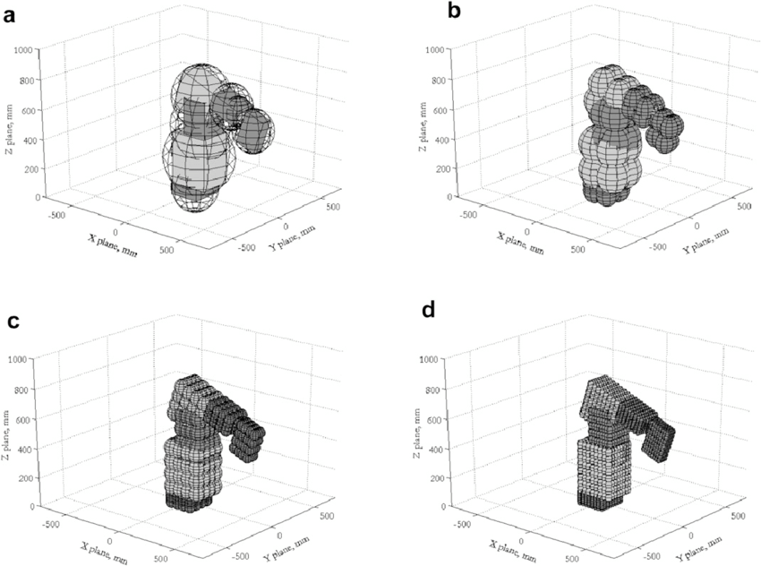
Spheres are generally use to represent the bounding box of a robotic arm.
Smaller spheres more closely represent the exact shape of the robotic arm. But there are lot more of them
Larger spheres. Less required, and provide a less accurate match of the robot’s foot print.
There are different way of representation, all provide different levels of resolution.
For collision detection:
The idea is to see if an obstacle as entered the a region encompassed by the sphere.
Source: https://www.researchgate.net/figure/Fig-A2-Bounding-sphere-representations-of-the-RV-E2-manipulator-a-one-sphere-per_fig8_47900908

Slide 8
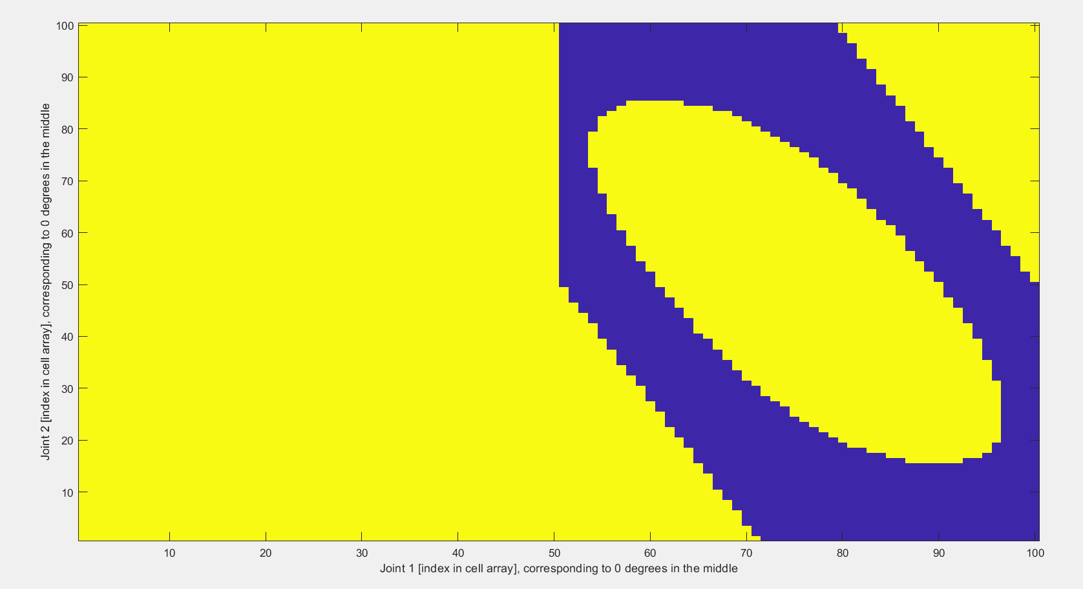
The configuration Space: C-space
Represents set of positions reachable by a robot’s end effector
The robot's forward and inverse kinematics equations define mappings between its configurations and its end-effector positions, or between joint space and configuration space
Essentially calculate the forward kinematic solution for a set of joint angles and determine if the robot is under collision in this state.
Doing this we can build up a map of the C-Space
For a 2 link arm. X axis represents joint 1. Y axis represents joint 1. Yellow = In collision Blue = Free

Slide 9
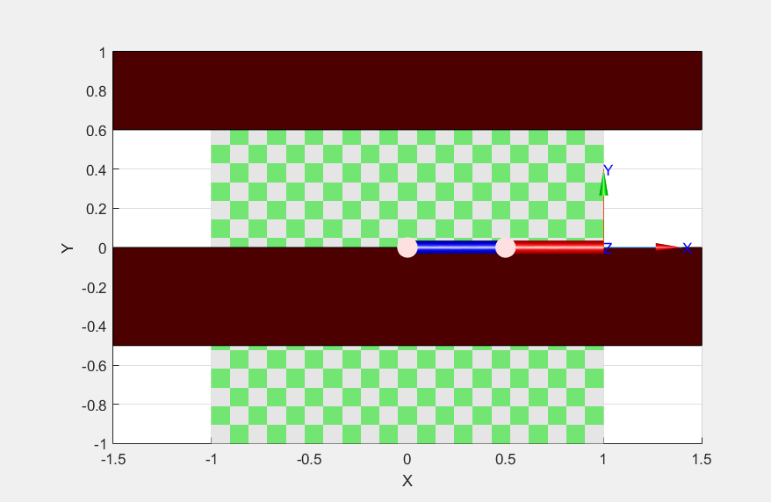
More details
This is the robot from lab08.
The red rectangles are obstacles.
Current joint angle config =
[0,0]
Not under collision

Slide 10
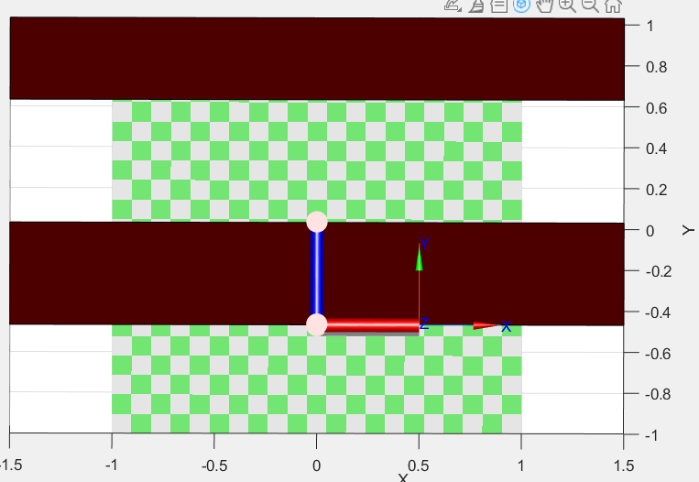
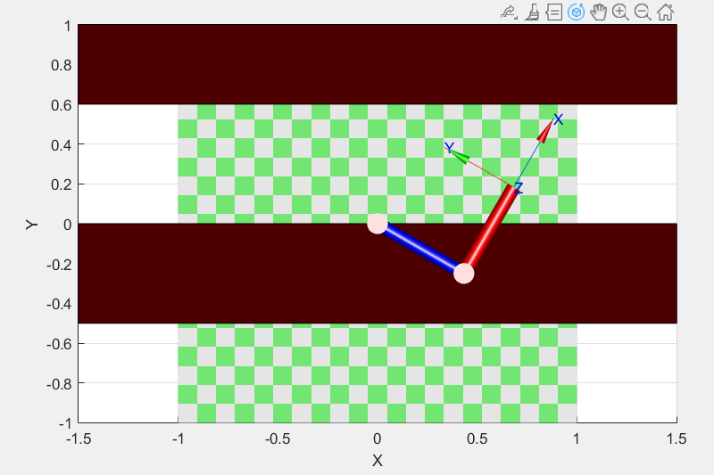
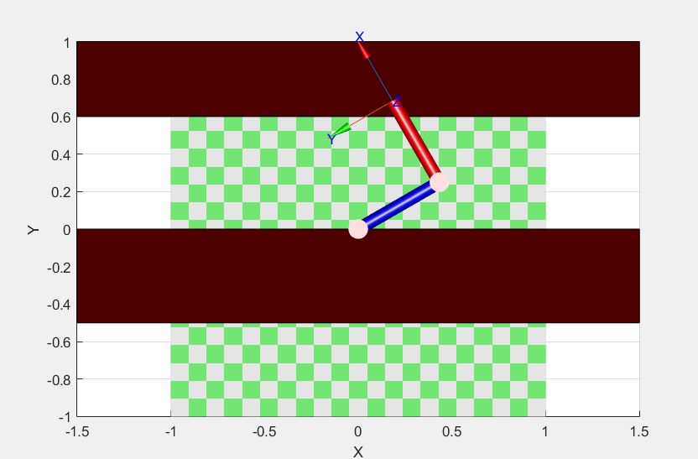
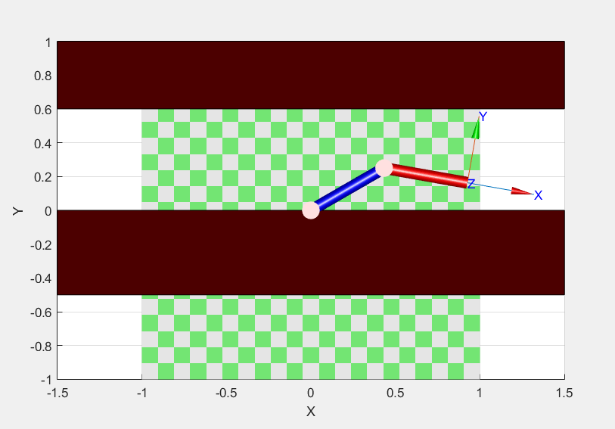
How do we generate the C-space?
Simulate the robot moving to every single joint angle possible and determine whether or not it is under collision.
[-90 90] : Collision
[-30 90] : Collision
[30 -40] : No Collision
[30 90] : Collision
https://www.cs.unc.edu/~jeffi/c-space/robot.xhtml > Play around with this cool website

Slide 11
Resolution of the C-space
The C-space isn’t a 1-1 representation of the joint space. It needs to be discretised.
C-Space is an occupancy grid. Each cell in the grid will have some fixed height and size.
We now know that to generate a C-space we need to identify whether or not there is a collision at each set of joint angles.
Depending on the resolution of our occupancy grid we can represent the area around the robot in more or less detail

Slide 13
Resolution of the C-space
If our first measurement was at [-90, 90] how do we decide on what our next step will be?
[-90,90.1] is valid
[-90,90.001] is valid
[-90,90.2] is valid
[-90, 90.5] is valid
[-90, 100] is valid
The smaller our steps are, the more accurate representation of the world we will get. BUT requires more computation time to generate the C-space.
Maybe if we go too small it could be redundant
If we use larger steps, less accurate representation of the world. But less samples, so less computation time.
If our steps were too large, we might miss obstacles entirely!

Slide 14
What’s the resolution for the lab?
Each step for us is going to be 1 degree.
Joint 1 : -180 to +180 (360 steps in total)
Joint 2 : -150 to 150 (300 steps in total)
C-space is to be 100 x 100
Resolution for joint 1 = 360/(100-1) = 3.63 degrees
Resolution for joint 2 = 300/(100-1) = 3.03 degrees
3.03
degrees
Each cell
3.63 degrees

Slide 15
What’s the resolution for the lab?
What does that mean?
Maybe we start at [-90,90] ([joint1, joint2])
And our next step is at [-90,91]
Because our resolution is 3.03 degrees for joint 2, we’re still going to be on the same cell on the occupancy grid.
Maybe [-90, 90] wasn’t a collision but [-90,91] was. Now that entire cell will be classified as a collision.
Now because the cell that [-90, 90] has been declared as a collision the robotic arm cannot move to that joint angle configuration anymore.
Joint 2:
3.03
degrees
Each cell
Joint 1: 3.63 degrees

Slide 16
What’s the resolution for the lab?
We could increase the resolution:
Requires more computation time.
How small do we go, till it becomes redundant?
We could decrease the resolution:
Decreases computation time.
Could miss out on a lot of possible configurations.

Slide 17
Now imagine doing this for a 3DOF arm or a 6DOF arm
It’s very computationally intensive.
The main point is to understand what is happening under the hood for the simple examples in this lab.

Slide 18
Lab08 Tasks
Look up the D* and the PRM Path planners using the RVC Toolbox’s RTB Manual.
Implement them!
The variable ‘config_space_binary’ contains the configuration space or the cost map.
Use the transposed values of it, due to Matlab’s ordering of indices in the cost map array.
i.e. use (config_space_binary’) when calling the constructor of a path planning algorithm!

